Slide 1

Election System
Group 16

Slide 2
Overview
Introduction
Objectives
Feasibility Study
Functional & Non-Functional Requirements
System Architecture
Implementation Details
Test Cases & Reports
Presentation Title

Slide 3

Introduction
The Online Election System is a web-based application designed to facilitate and streamline the election process by enabling voters to cast their votes online securely and efficiently. The system aims to provide a user-friendly platform for both voters and administrators, ensuring transparency, accuracy, and integrity throughout the entire election process.

Slide 4



Protect voter data with encryption and multi-factor authentication to prevent unauthorized access and maintain vote privacy.
Streamline voter registration and eligibility verification for quick and easy access to the election platform.
objective
Implement logs and audit trails to track actions, ensuring accountability and transparency without revealing voter identities.
Election System

Slide 5
Feasibility Study
Technical Feasibility : Election – system is developed using prominent web technologies like react, postgres and integrates with fastapi.
Economic Feasibility : The economic feasibility of the online election system ensures that the benefits and efficiencies gained from digitizing the election process outweigh the costs of development, deployment, and maintenance.
The system is economically feasible and if it achieves widespread adoption, offers clear benefits.
Operational Feasibility : The operational feasibility of the online election system assesses whether the platform can be smoothly integrated into existing election processes, is user-friendly for both administrators and voters, and reliably supports secure, efficient, and scalable voting operations.
Legal Feasibility : The legal feasibility of the online election system ensures that the platform complies with electoral laws, data protection regulations, and privacy standards, safeguarding voter rights and election integrity while meeting all legal requirements for secure, valid digital voting.

Slide 6
Functional Requirements
These requirements describe the system's behavior and the specific functions it must perform to support voters, administrators, and candidates during the election process.
User Registration with Organization Email Verification
Requirement: The system must allow voters to register using Google OAuth with their organization-issued email addresses (e.g., @organization.com). Only email domains associated with the organization should be permitted, ensuring that only eligible organization members can register for the election system.
User Verification through Google OAuth and Organization ID Check
Requirement: The system should verify user eligibility by ensuring they authenticate through Google OAuth with a valid organization email address. If additional verification is required, the system may prompt for organizational ID information (e.g., studentID) to finalize eligibility.
Election System

Slide 7
Functional Requirements
Candidate Registration:
Candidate Enrollment:
Requirement: The system must allow eligible users to register as candidates in the election by filling out a candidate application form, including details like name, college ID, department, and position they intend to run for.
Candidate Verification and Approval :
Requirement: The system should automatically verify candidates' eligibility based on college policies (such as academic standing, age, or department) and may require additional approval by election administrators.
Election Management :
This module enables administrators to set up and manage election cycles, including defining schedules, approving candidates, and managing voter lists. It supports ballot customization, monitors voting progress, and securely calculates and publishes results. These tools ensure a fair and transparent election process, aligning with college guidelines.
Election System

Slide 8
Non-Functional Requirements
Performance Requirements :
Scalability: Handle high user traffic, especially on election day
Availability: 99.9% uptime during critical periods.
Load Handling: Support a high number of transactions per second.
Safety and Security Requirements :
Data Encryption: Encrypt all sensitive data (e.g., votes, personal information) during transmission and storage.
Authentication and Authorization: Implement strong authentication methods (e.g., multi-factor authentication) for users and also ensure proper access controls and permissions to restrict access based on their roles.
Election System

Slide 9
Non-Functional Requirements
Software Quality Attributes:
1. Performance:
Description: Measures how well the system performs under various conditions, including speed, responsiveness, and resource usage.
Examples: Response time, throughput, and load handling
Reliability:
Description: Indicates the system's ability to consistently perform its functions without failure over time.
Examples: System uptime, error rates, and fault tolerance.
Election System

Slide 10
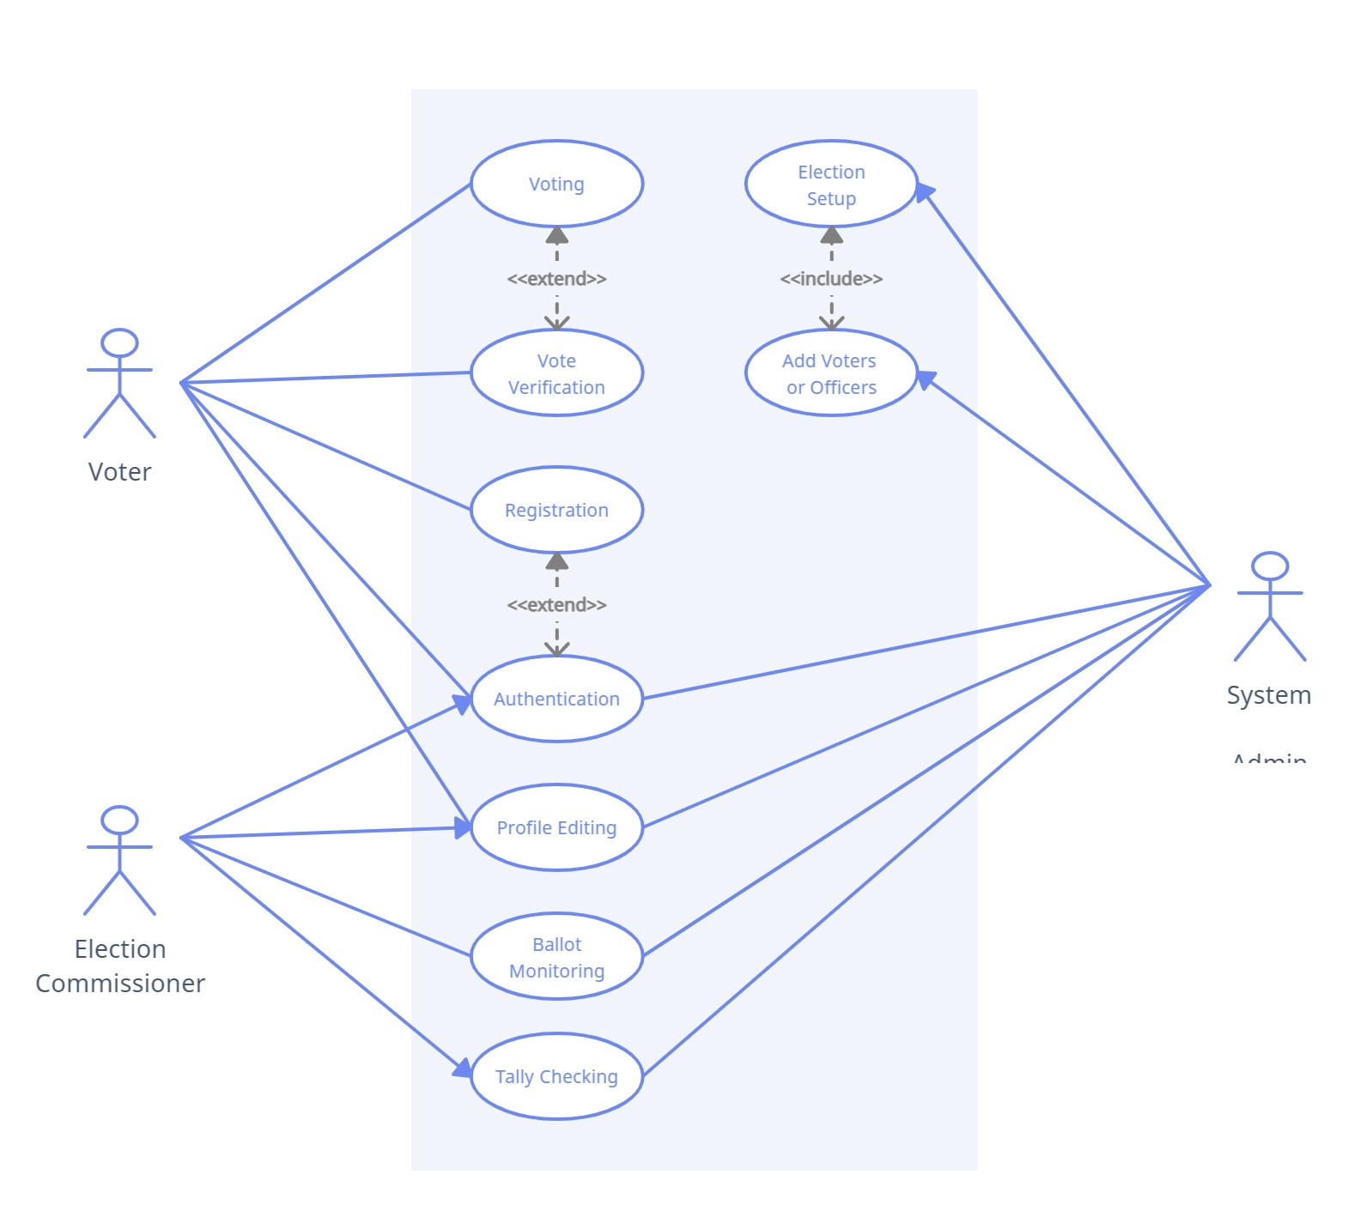
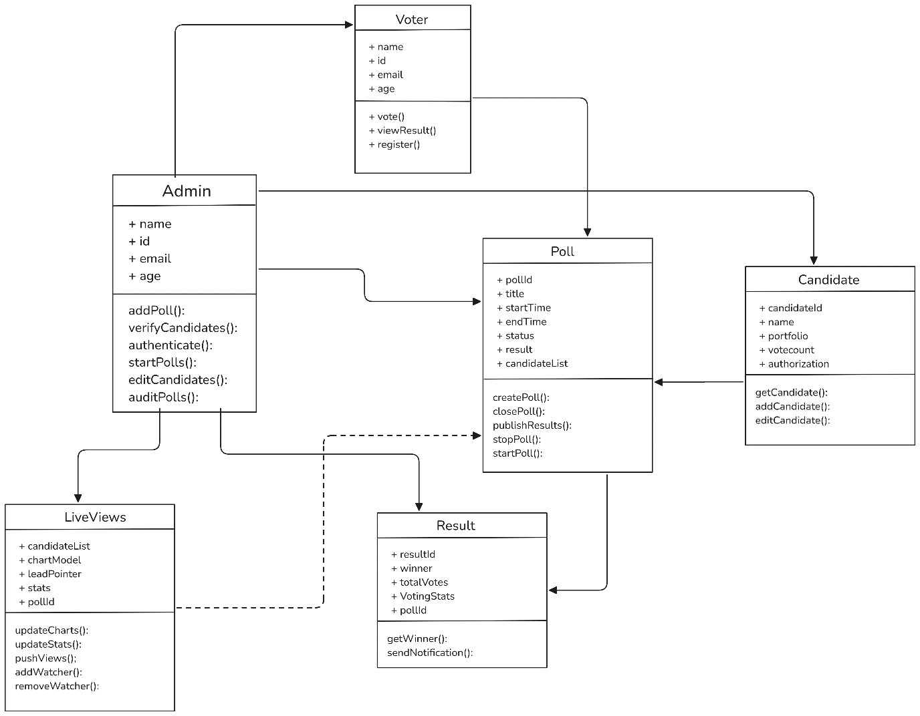

UML Diagrams

Slide 11
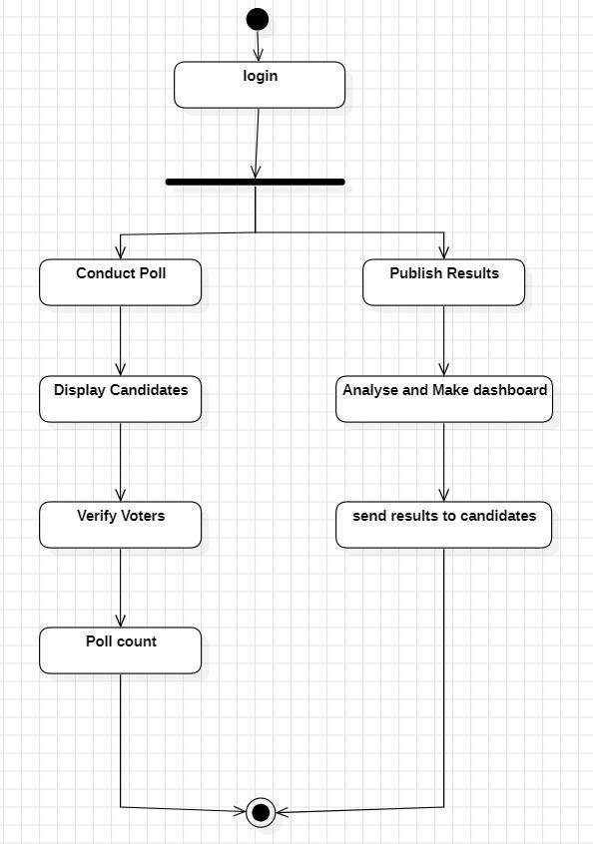
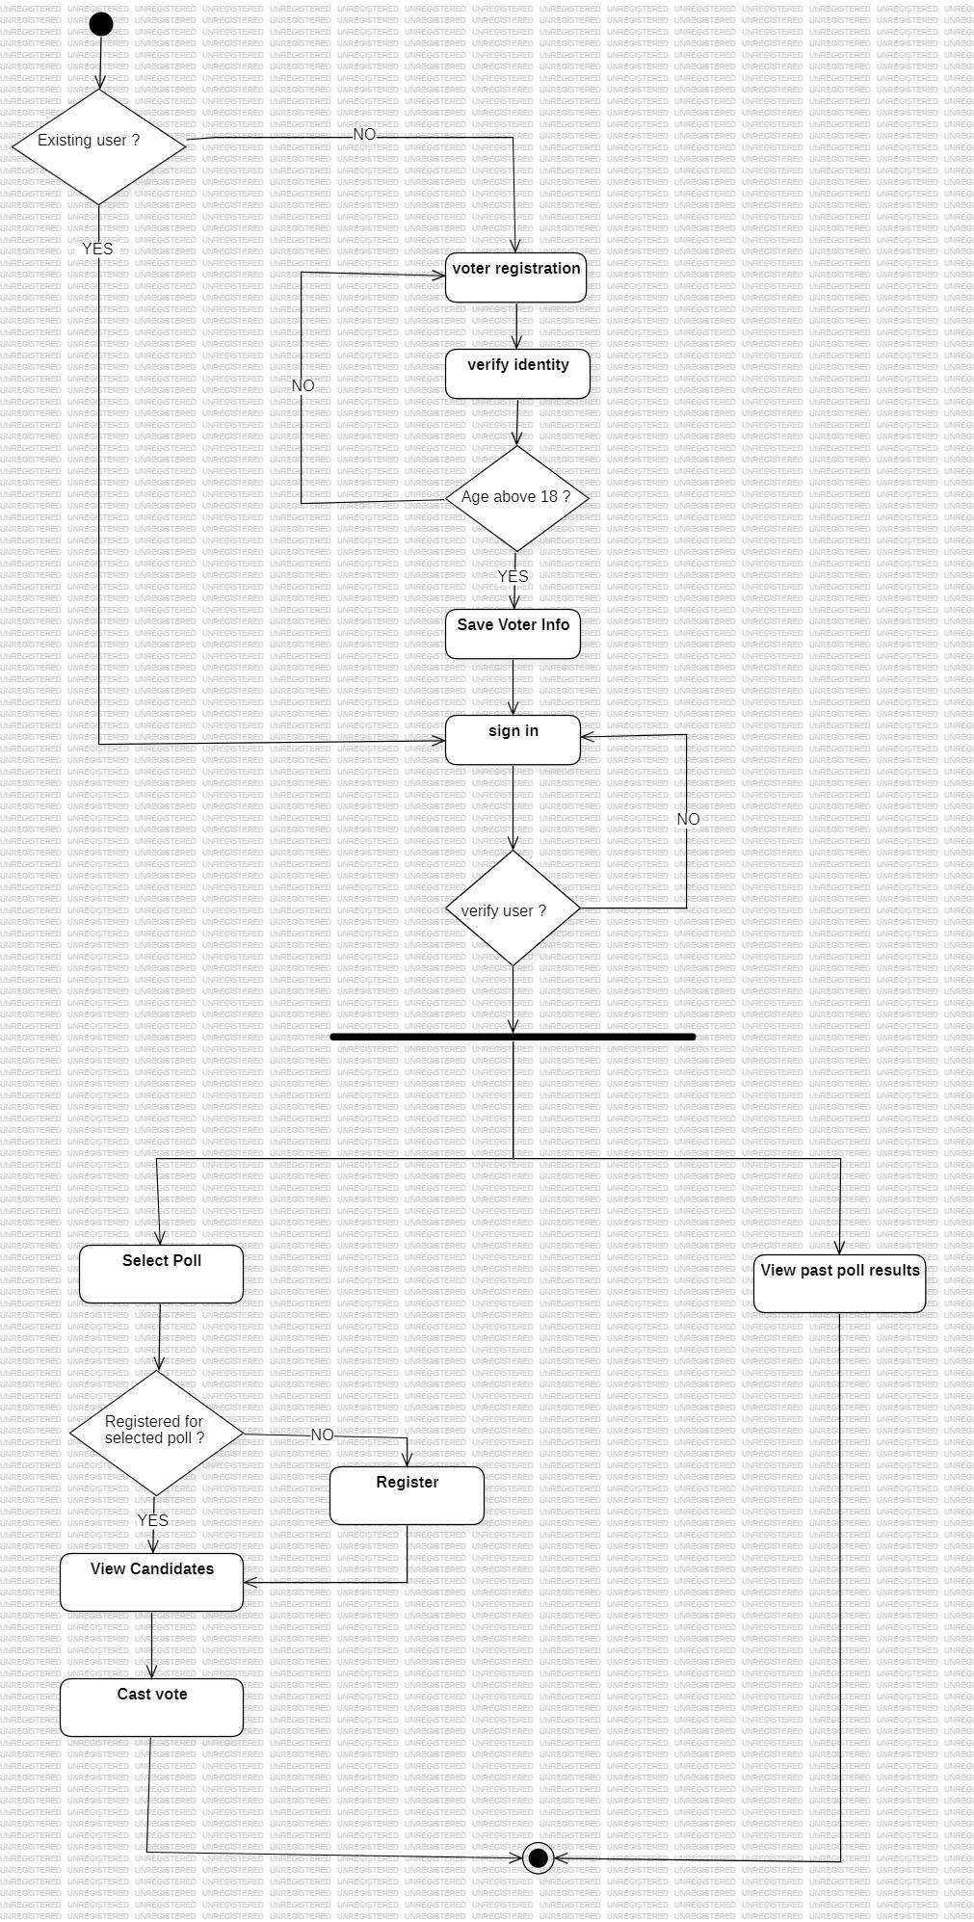
UML Diagrams

Slide 12
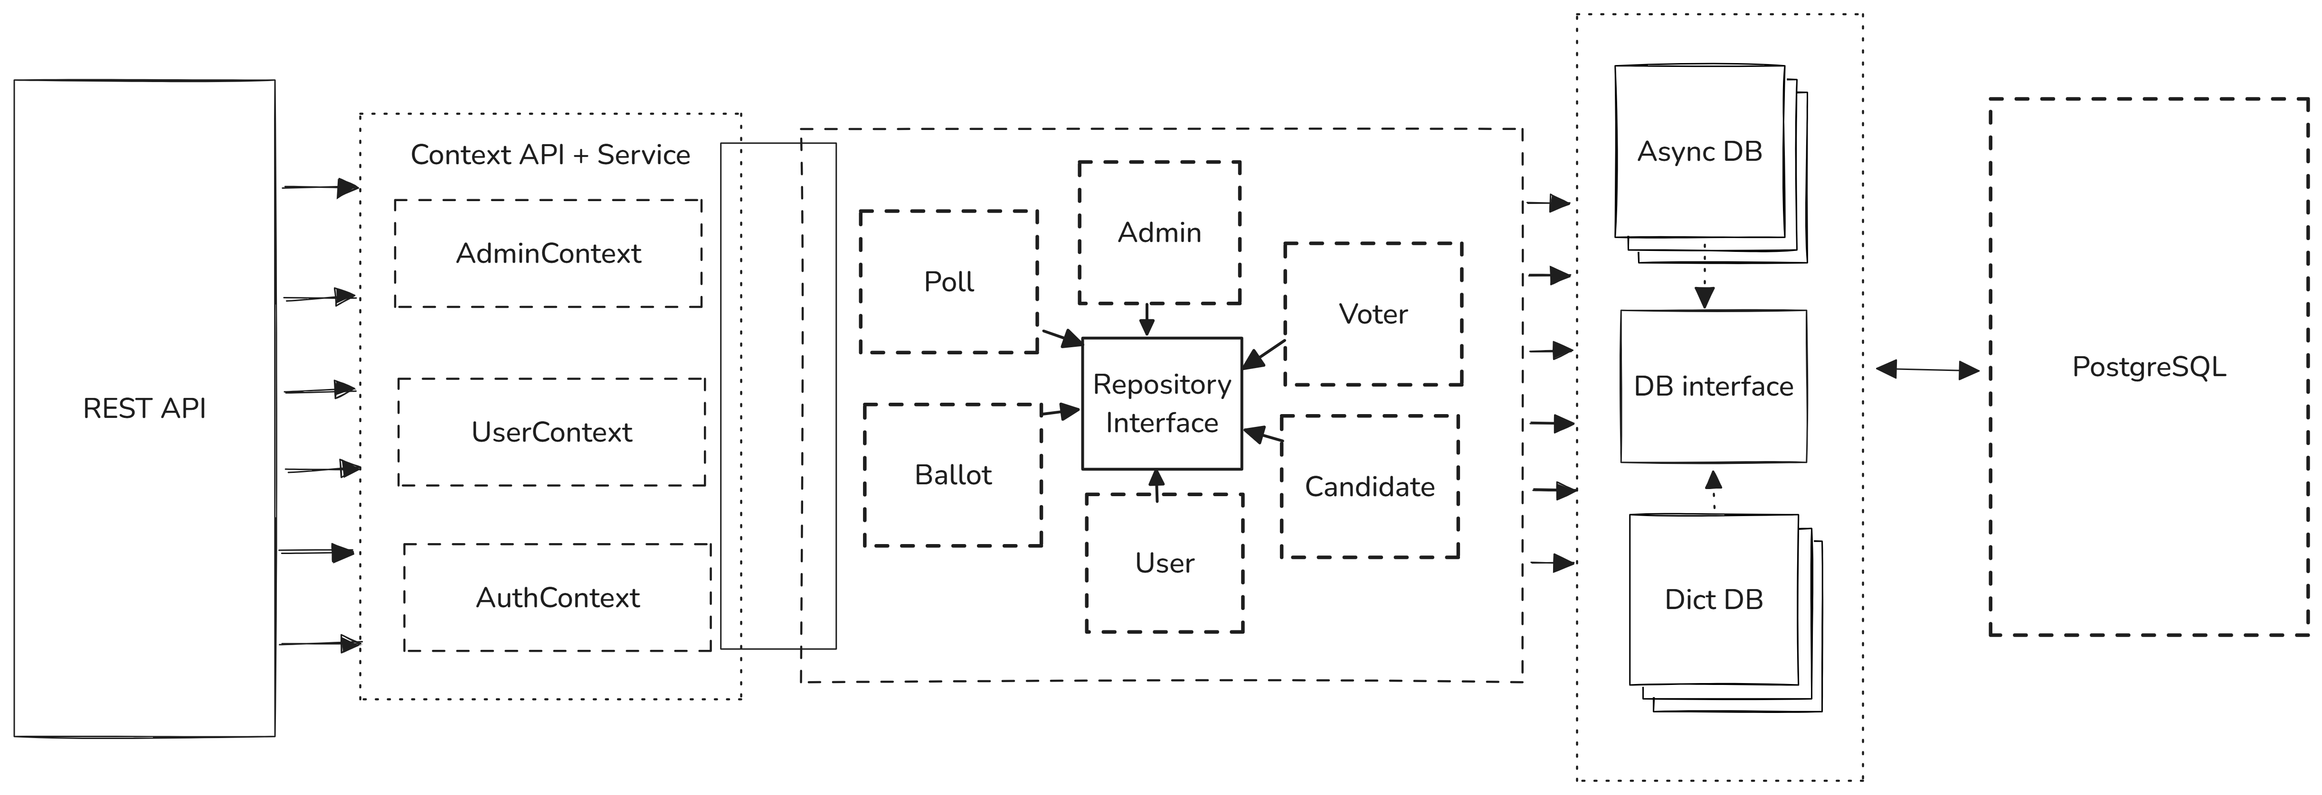
System Architecture

Slide 13




Implementation
React js : Build Dynamic UI’s faster than ever
FastApi : Blazing fast API’s, built in flash. FastApi – speed meets simplicity.
Postgres : Powerful, reliable, open-source. Trust in tour data with PostgreSQL.
SQLAlchemy : Effortless database interaction,
Python-style.SQLAlchemy – SQL,simplified.
12 – Factor App : Code once scale anywhere

Slide 14
Test Cases and Reports
TEST set – 1
TC 01 Voter Registration
Description : Test Successful, account logged in and registered successfully.
Expected Result : Account logged in and registered successfully confirmation.
Status : Pass.
TC 02 Poll Creation
Description : Test Successful, Polls are successfully created by the admin.
Expected Result : Poll should be created successfully, and admin must be able to see the
Poll data.
Status : Pass.

Slide 15
Test Cases and Reports
TEST set – 1
TC 03 Candidate Enrolment
Description : Candidates are supposed to be visible in their respective registered polls.
Expected Result : Candidates must be successfully enrolled and must be visible in their respective polls.
Status : Failed.
TEST Report – 1 :
Test Summary :
Test Date: 18-10-24
Modules Tested: Voter Management, poll creation, Candidate enrollment.
Total Test Cases: 3
Passed: 2
Failed: 1

Slide 16
Test Cases and Reports
TEST set – 2
TC 01 Cast Vote
Description : Voters who are eligible for a particular poll, must be able to cast their vote.
Expected Result : Prompt message that ensures that vote has been cast successfully.
Status : Pass.
TC 02 Result Publication
Description : An email have been sent to each of the voters in the organization regarding the result of a poll.
Expected Result : Every voter must receive a mail regarding results of the poll that he/she have participated.
Status : Pass.

Slide 17
Test Cases and Reports
Test Report – 2
Test Summary :
Modules Tested: Voter Management, poll creation, Candidate enrollment.
Total Test Cases: 2
Passed: 2
Failed: 0
Remarks : Every Test case have been passed successfully.

Slide 18


Summary
The online election system aims to modernize the voting process by offering a secure, accessible platform for elections. It allows voters to register, verify their identities, and cast ballots privately and securely, addressing privacy and authentication through encryption and multi-factor authentication. Additionally, the system supports real-time result tallying, enabling instant reporting and insightful analytics.

Slide 19




THANK YOU

